Slide 1
Group 3
Lane Detection via Physical Algorithms
Final Presentation
March 11
Ashwani Aggarwal & Shihe Pan

Slide 2
Role of Each Member
Pre-midterm:
Work was done in a pair programming setting as most tasks needed to be done linearly
Post-midterm:
Ashwani worked mainly on PhyCV preprocessing strategies
Shihe worked mainly on neural network training with preprocessed data
Result analysis was done together
Presentation
Divided into sections that are evenly distributed between members

Slide 3
Outline
Lane line detection: motivation
PhyCV algorithms: PST / VEViD
Dataset: BDD100K
Lane line detection benchmarks: YOLOP / TwinLiteNet
Evaluation metrics: Pixel Accuracy / IOU
PhyCV preprocessing
Neural network training process / results
Conclusion & Outlook
Background
Methods
Results
Conclusion

Slide 4
Why is lane detection important?

Slide 5
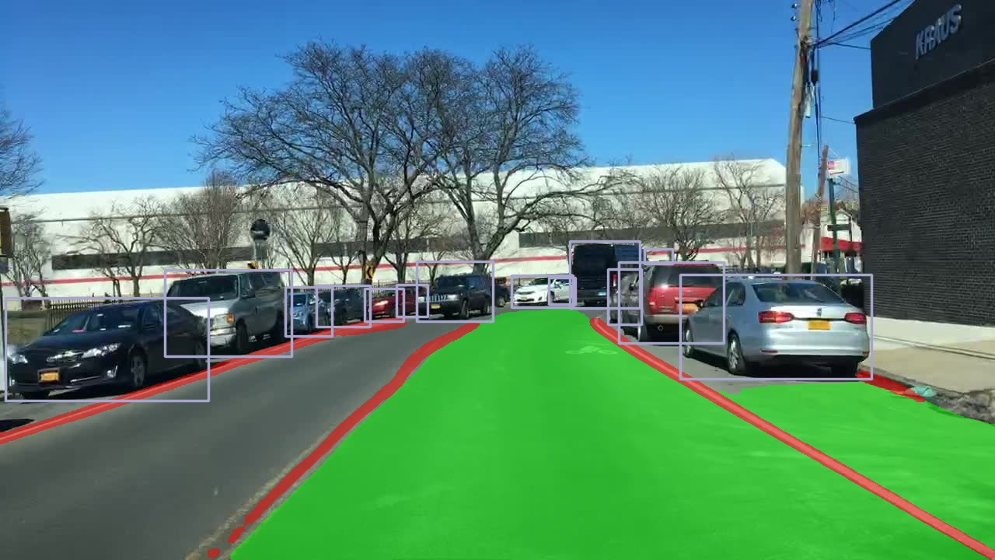
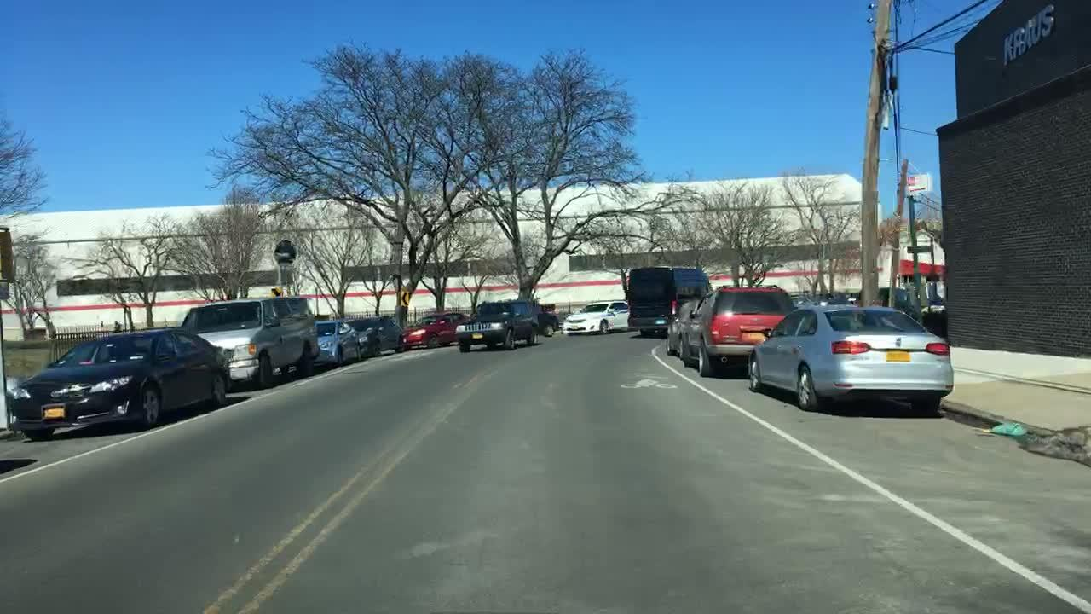
Motivation
Detection task
Object detection
Help the vehicle to avoid obstacles
Autonomous
driving system
Drivable area segmentation
Plan the driving route of the vehicle
Lane detection
Segmentation task
Neural network
Source: https://arxiv.org/abs/2108.11250

Slide 6
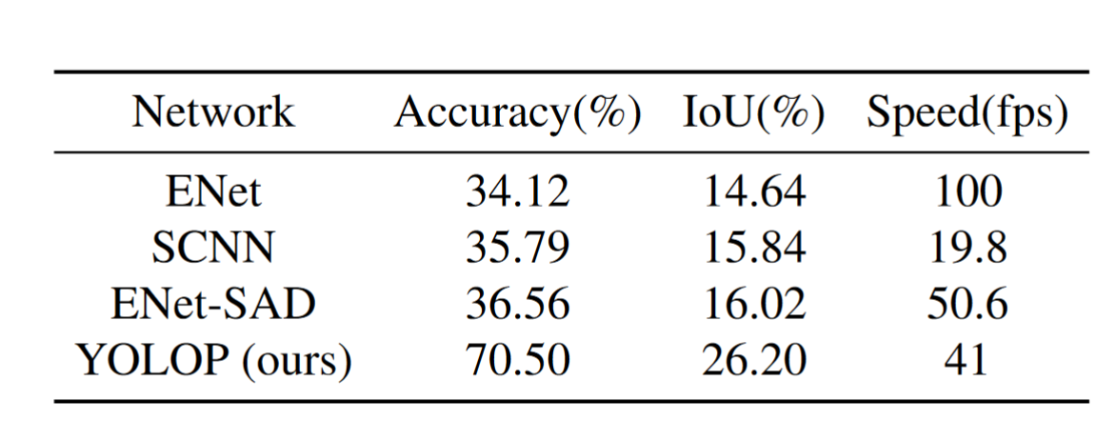
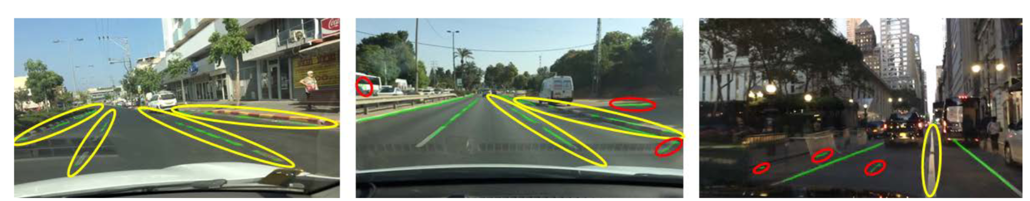
Motivation
(By 2022)
Essential requirements:
High precision
Real-time responsiveness - 30 fps
Lightweight
Source: https://arxiv.org/abs/2108.11250
ENet-SAD
Source: https://arxiv.org/abs/2108.11250
How to improve? → Use phase stretch transform (PST) for preprocessing

Slide 7
PhyCV – PST / VEViD

Slide 8
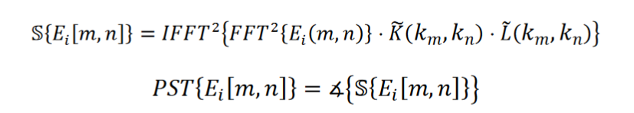
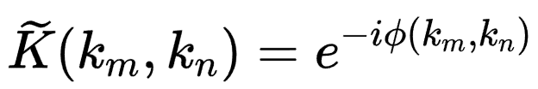
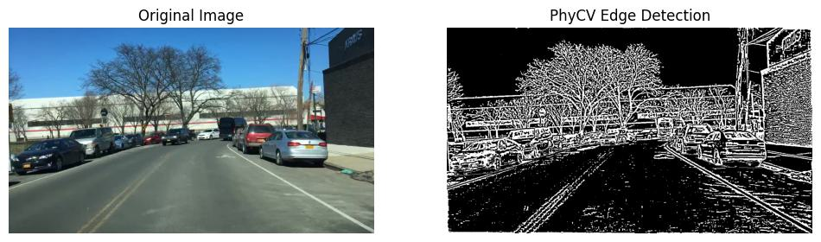
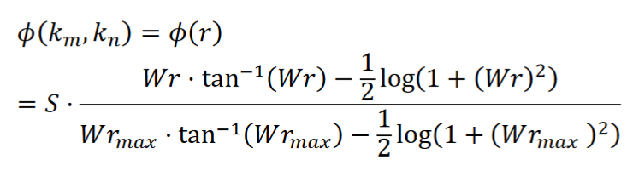
Phase-Stretch Transform (PST)
2D discrete stretch operator
Input image in spatial coordinates
Gaussian low pass filter for imaging denoising
Angel operator
“...applies higher amount of phase to
higher frequency features”
Nonlinear frequency-dependent phase filter
Source: https://arxiv.org/pdf/2301.12531.pdf

Slide 9
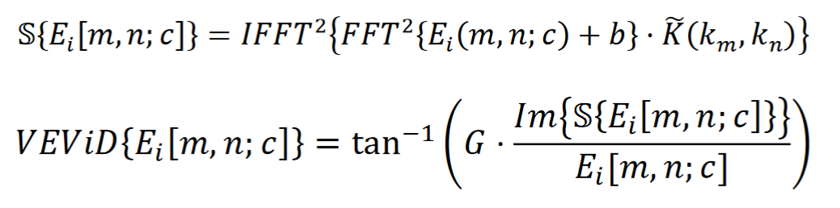
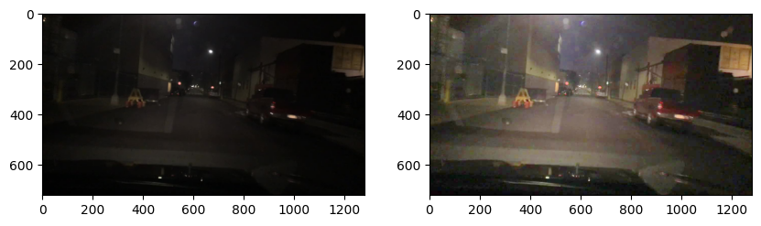
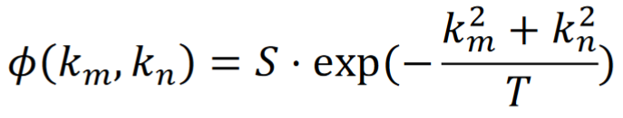
Vision Enhancement via Diffraction and Coherent Detection (VEViD)
Value channel in the HSV space
Regularization
Phase activation gain
Phase kernel
Source: https://arxiv.org/pdf/2301.12531.pdf

Slide 10
BDD100K Dataset

Slide 11
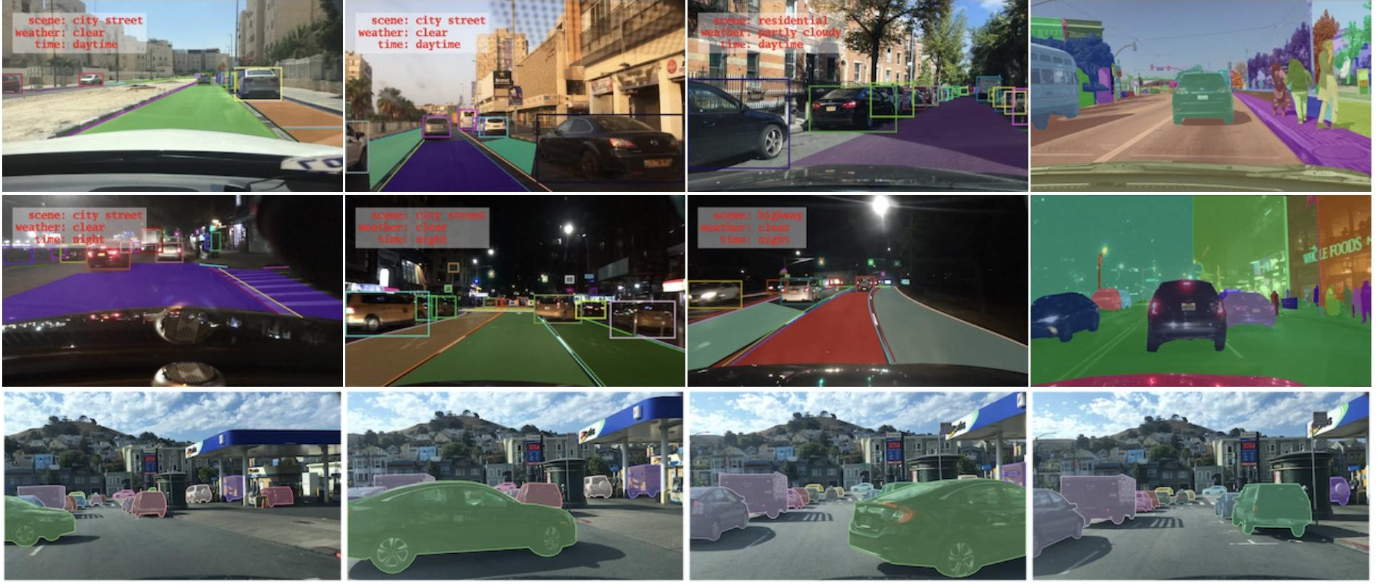
BDD100K Dataset
Includes data for a variety of tasks - lanes, objects, drivable area - under diverse conditions. Contains 100K Images - 70k train, 10k validation, 20k test.
Source: https://arxiv.org/pdf/1805.04687.pdf

Slide 12
Benchmarks: YOLOP, TwinLiteNet

Slide 13
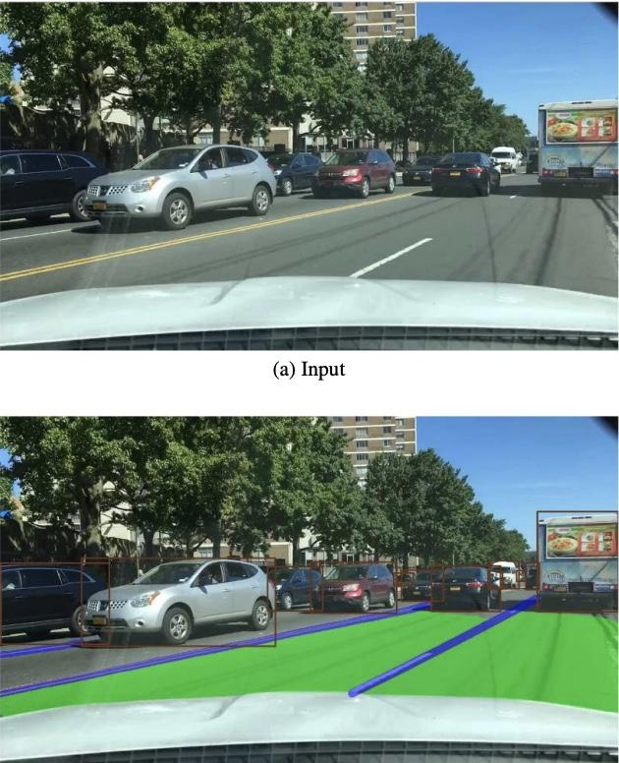
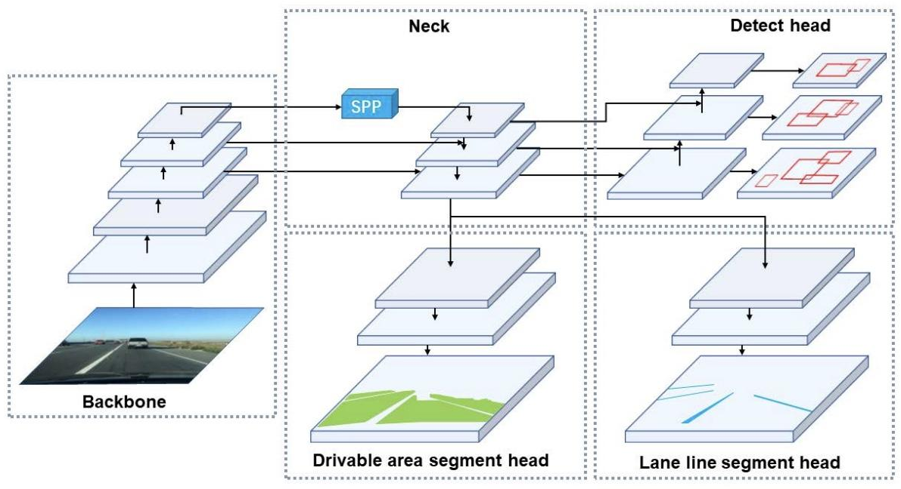
YOLOP - Large Baseline
You Only Look Once for Panoptic Driving Perception (YOLOP) is a multitask model for object, drivable area, and lane detection that will be our larger baseline.
1 shared encoder, 3 separate decoders (7.9 million trainable parameters)
Source: https://arxiv.org/pdf/2108.11250.pdf

Slide 14
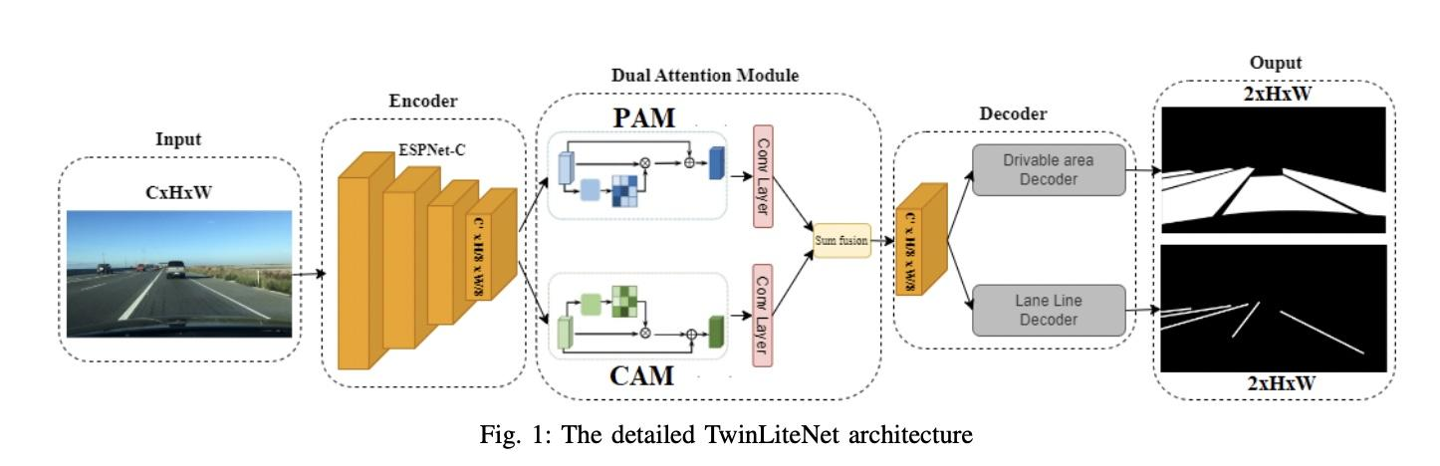
TwinLiteNet - Smaller Baseline
TwinLiteNet is a significantly smaller model (0.4 million trainable parameters) based in part off of YOLOP for lane line detection and drivable area segmentation.
Source: https://arxiv.org/pdf/2307.10705.pdf

Slide 15
Evaluation Metrics

Slide 16
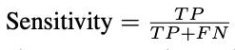
Evaluation Metrics - Line Accuracy
Problem: Due to class imbalance, accuracy will always be very high.
Solution: Calculate accuracy only for the lines (ratio of correctly marked lane pixels to total ground truth lane pixels). We can also interpret this as the sensitivity.
Issue: Does not take into account background pixels labelled as lane lines (FP)
Source: https://arxiv.org/pdf/2310.01641v3.pdf

Slide 17
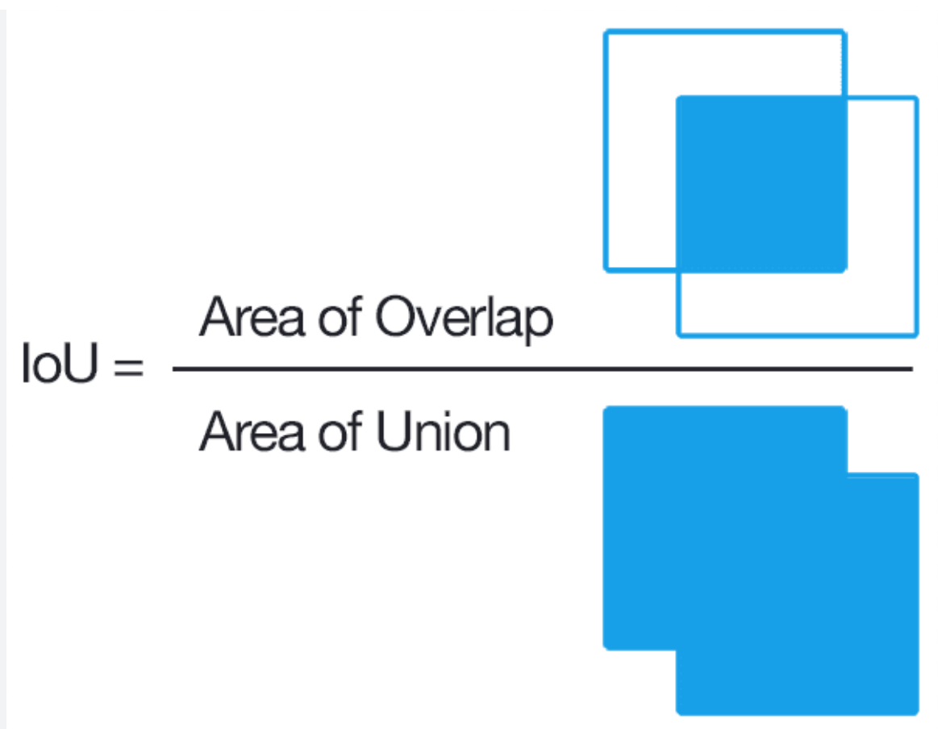
Evaluation Metrics - IoU (Intersection over Union)
Intuition: Intersection of predicted and actual lanes divided by union of predicted and actual lanes.
Also have mIoU where we calculate this for background as well and average.
Can be calculated in practice as TP / (TP + FN + FP)
Source: https://zihaogeng.medium.com/how-to-evaluate-an-object-detection-model-iou-precision-recall-and-map-f7cc12e0dcf6

Slide 18
PhyCV preprocessing

Slide 19
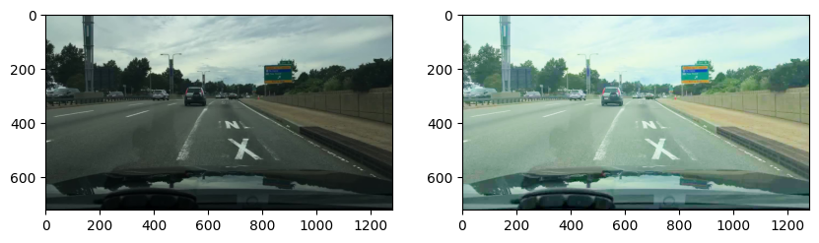
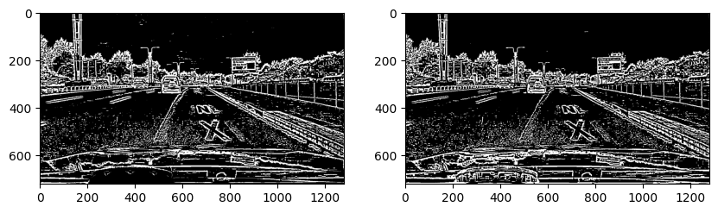
PST can highlight lane lines in image

Slide 20
Pre-Processing Pipeline
Digital
VEViD
Yes
morph_flag=1
Image
Night?
No
PST
Output
morph_flag=0
Analog

Slide 21
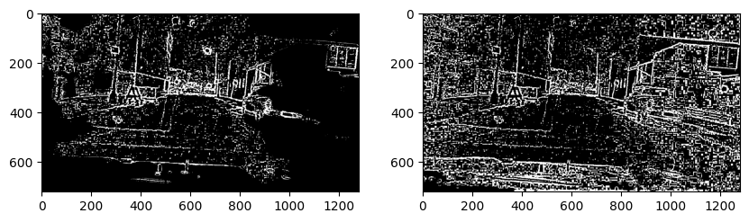
Why use VEViD + PST on night images?
VEViD
PST

Slide 22
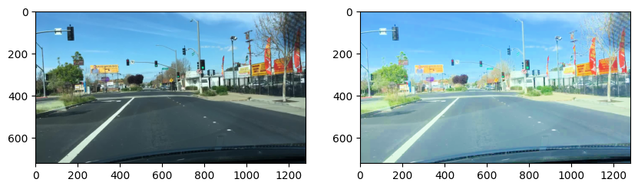
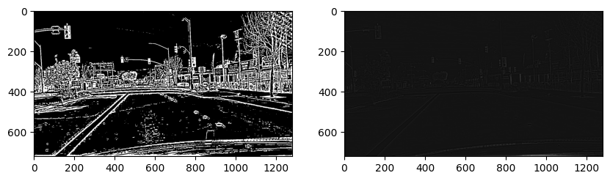
Digital vs Analog Output
Normally, PST converts output to 0 or 1 digital pixels based on quantile thresholds. Does analog output contain more information?
Digital Output
morph_flag=1
Analog Output
morph_flag=0

Slide 23
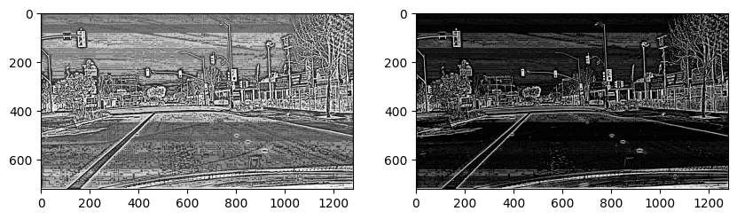
How can we fix the Analog Output?
Convert data to percentiles (make distribution more uniform)
Pass every pixel to x⁵ function (make distribution concentrated on dark pixels)
Step 1
Step 2

Slide 24
Training Results

Slide 25
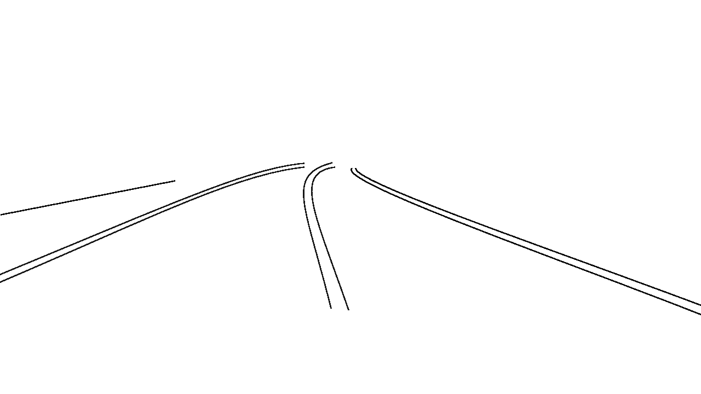
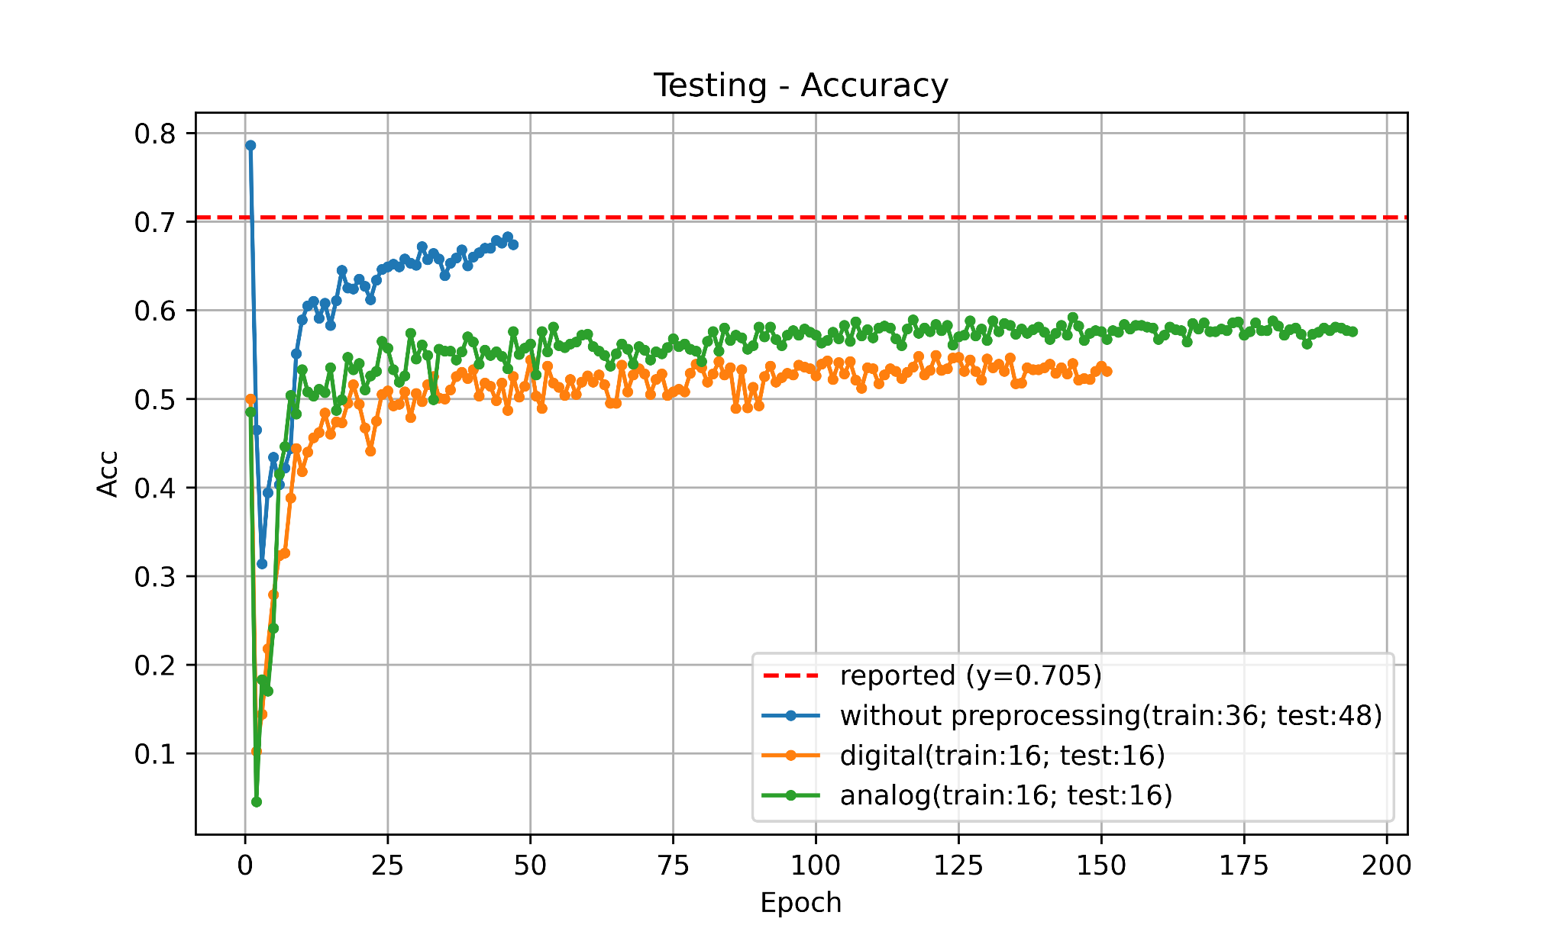
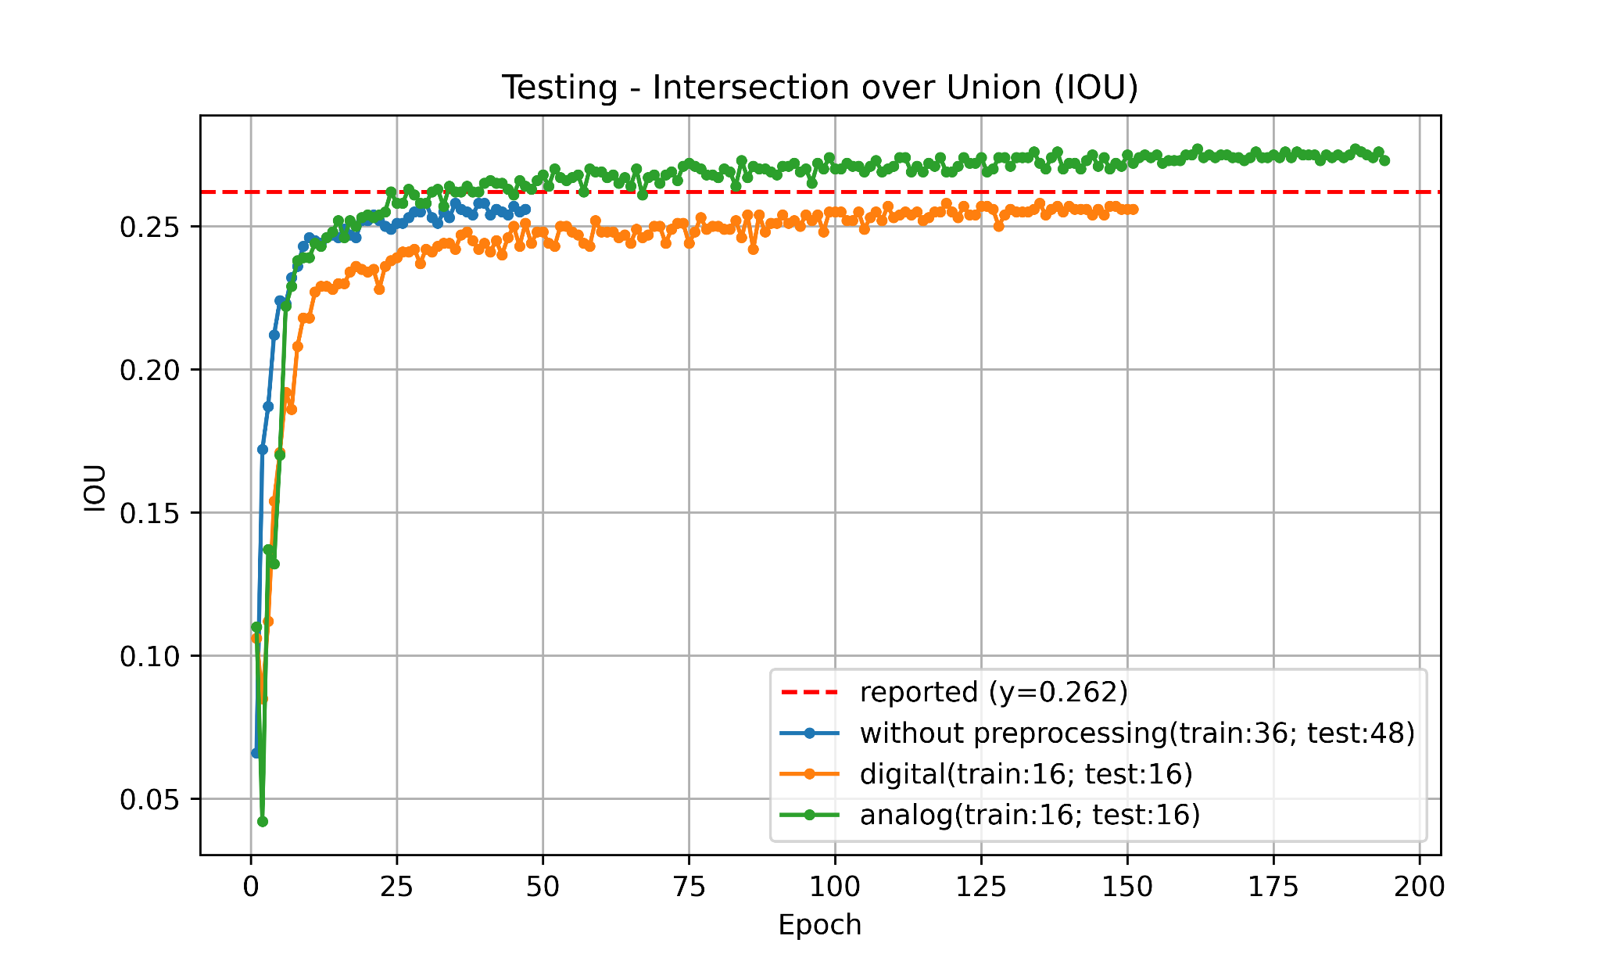
Training Process (YOLOP)
imbalance between lane lines and other area
Pixel Accuracy vs. Epoch
Accuracy ✗
IOU ✔
IOU vs. Epoch

Slide 26
Accuracy vs IOU
Which one is a better metric for lane detection?
The key difference is that IOU has FP in the denominator whereas Accuracy does not
This means that an accuracy that predicts everything as a lane line would have perfect accuracy but poor IOU
Thus, IOU is a more robust metric for evaluation (and also a much harder metric)

Slide 27
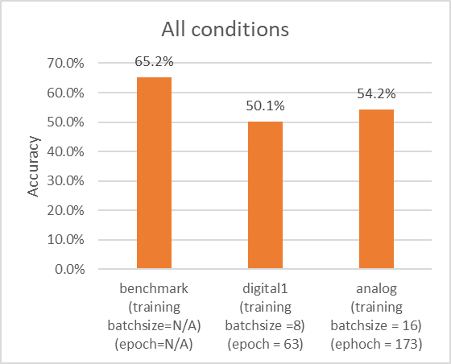
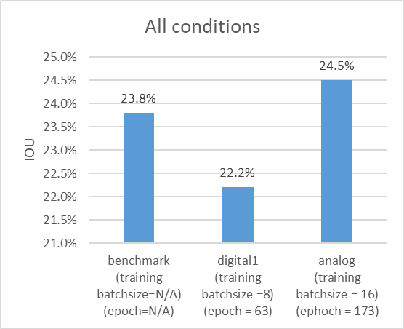
YOLOP Results
 | All (10,000 Images)
Benchmark | Acc (0.652) IOU (0.238) mIOU (0.611) 0.0300s/frame
Digital PhyCV Preprocessed Data | Acc (0.501) IOU (0.222) mIOU (0.604) 0.0304s/frame
Analog PhyCV Preprocessed Data | Acc (0.542) IOU (0.245) mIOU (0.616) 0.0303s/frame

Slide 28
YOLOP Results (night & foggy)
 | All (10,000 Images) | Night (3,929 Images) | Foggy (13 Images)
Benchmark | Acc (0.652) IOU (0.238) mIOU (0.611) 0.0300s/frame | Acc (0.625) IOU (0.227) mIOU (0.605) 0.0301s/frame | Acc (0.581) IOU (0.207) mIOU (0.596) 0.0240s/frame
Digital PhyCV Preprocessed Data | Acc (0.501) IOU (0.222) mIOU (0.604) 0.0304s/frame | Acc (0.483) IOU (0.215) mIOU (0.601) 0.0304s/frame | Acc (0.470) IOU (0.201) mIOU (0.595) 0.0350s/frame
Analog PhyCV Preprocessed Data | Acc (0.542) IOU (0.245) mIOU (0.616) 0.0303s/frame | Acc (0.498) IOU (0.234) mIOU (0.611) 0.0302s/frame | Acc (0.505) IOU (0.230) mIOU (0.609) 0.0463s/frame

Slide 29
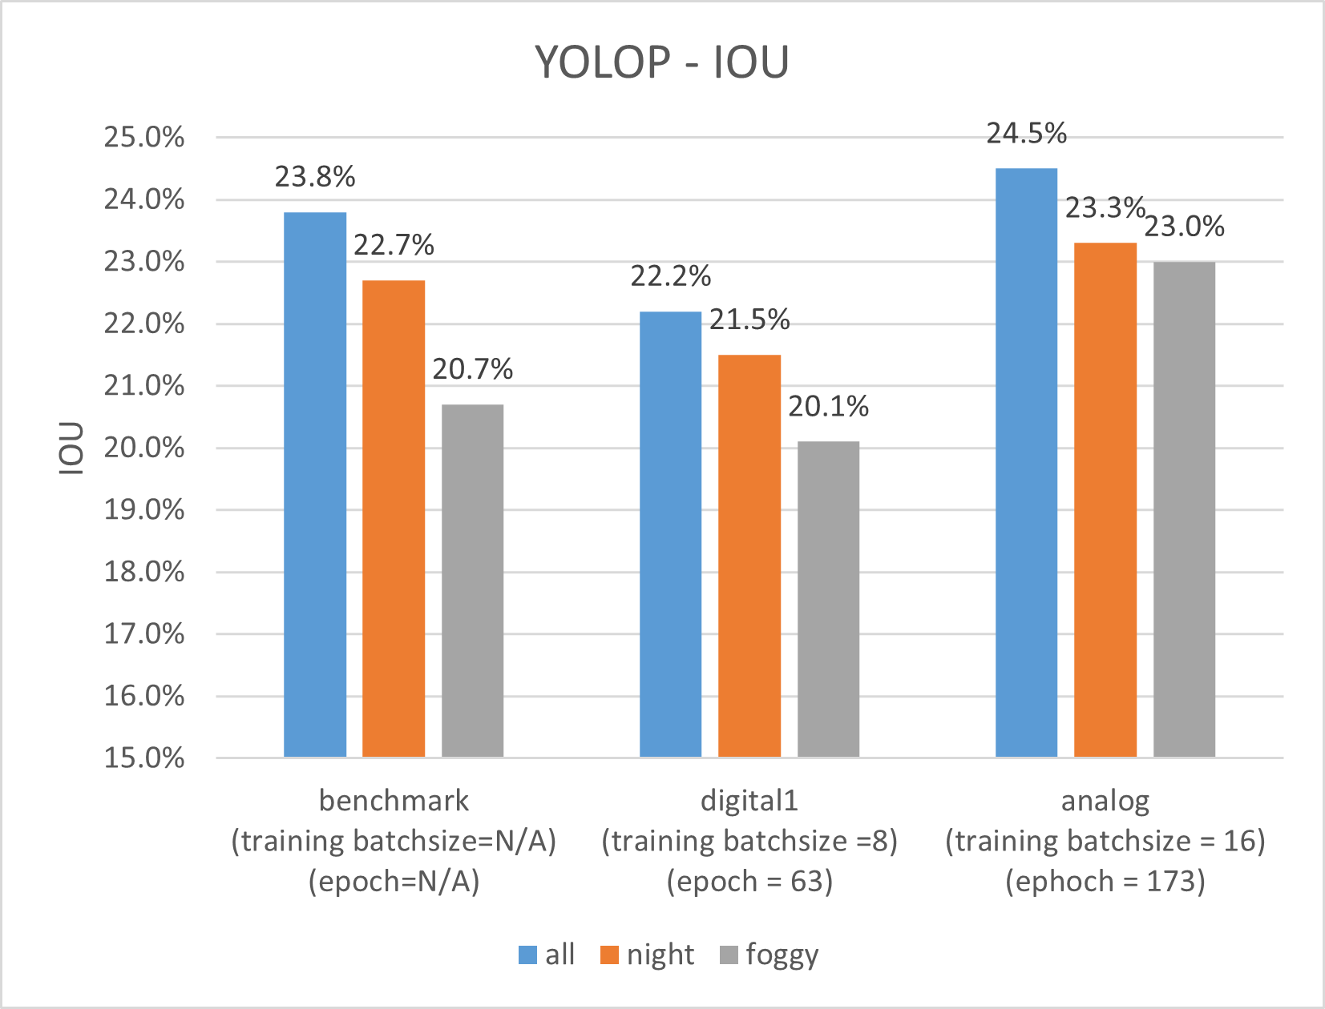
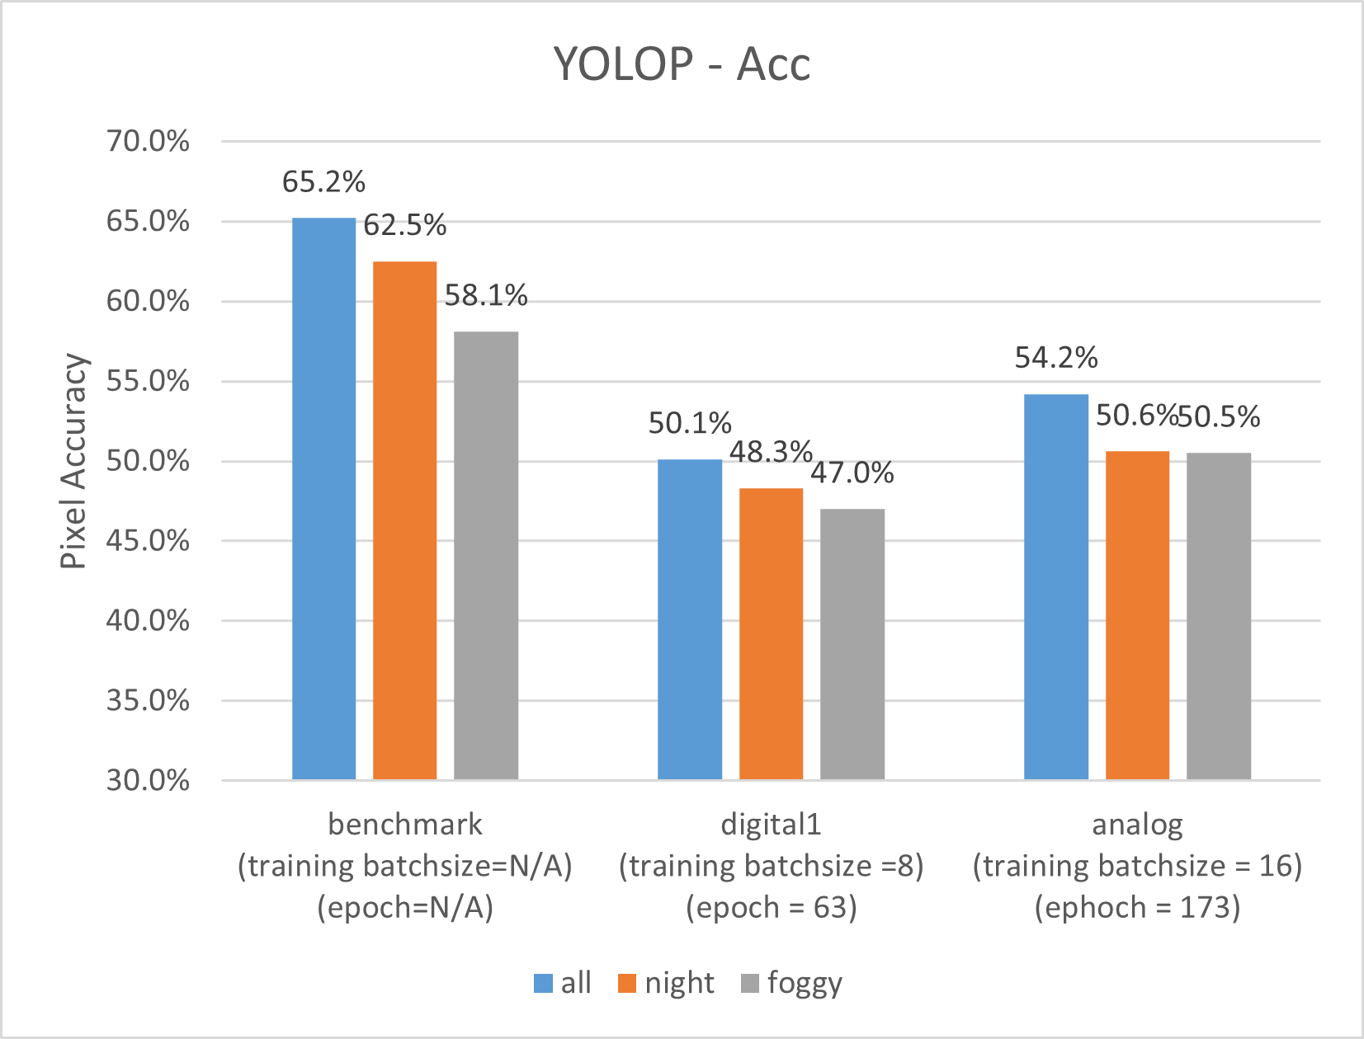
YOLOP Results (night & foggy)

Slide 30
TwinLiteNet Results
 | All (10,000 Images) | Night (3929 Images) | Foggy (13 Images)
Benchmark | Acc (0.504) IOU (0.272) mIOU (0.631) | Acc(0.461) IOU (0.254) mIOU(0.622) | Acc (0.379) IOU (0.223) mIOU(0.607)
Digital PhyCV Preprocessed Data | Acc(0.430) IOU (0.232) mIOU (0.610) | Acc(0.419) IOU (0.226) mIOU (0.608) | Acc(0.371) IOU (0.213) mIOU (0.602)
Analog PhyCV Preprocessed Data | Acc(0.481) IOU (0.257) mIOU (0.623) | Acc(0.459) IOU (0.247) mIOU 0.618) | Acc(0.371) IOU (0.215) mIOU (0.603)

Slide 31
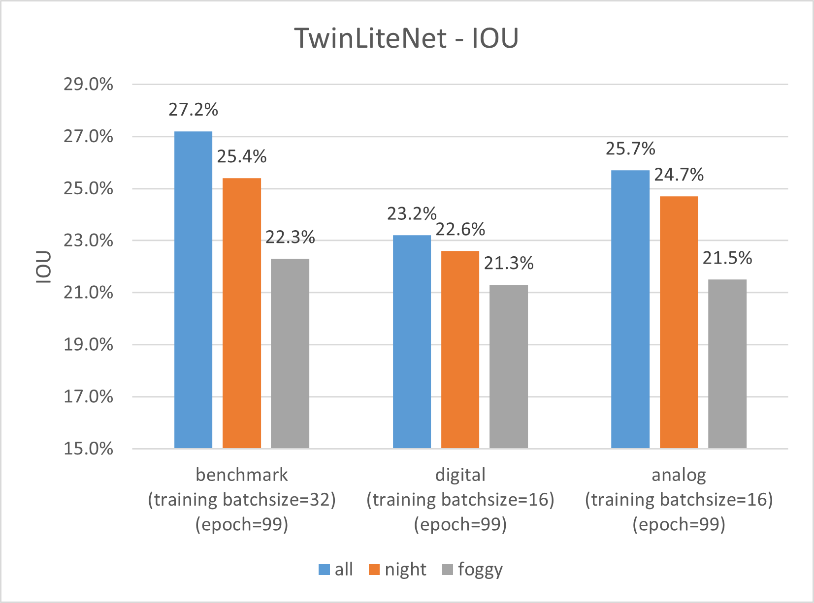
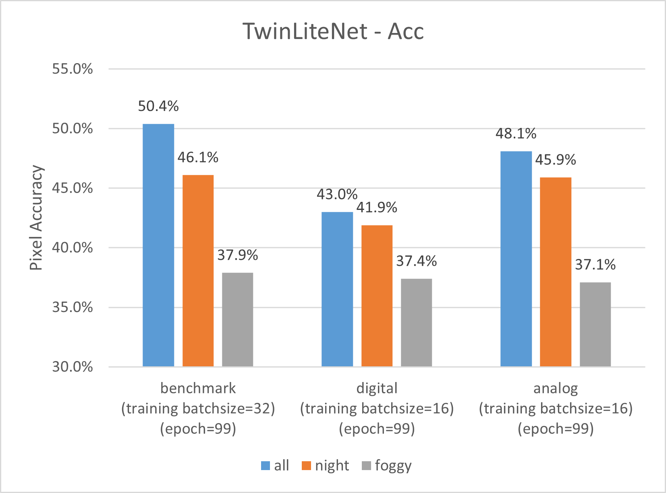

Slide 32
Inference Examples

Slide 33
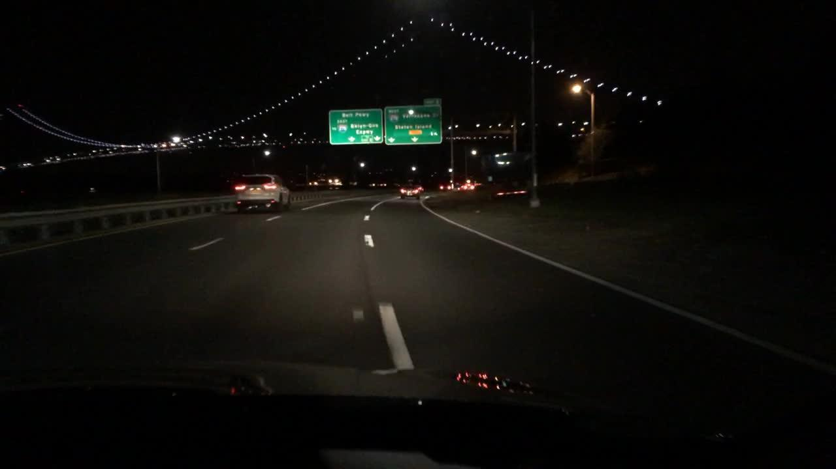
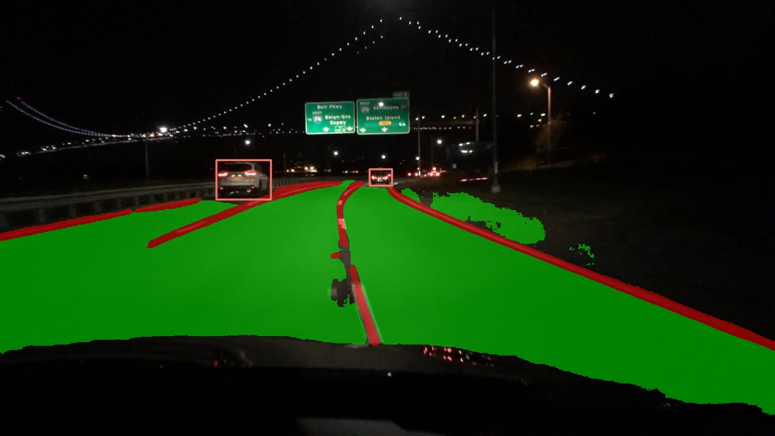
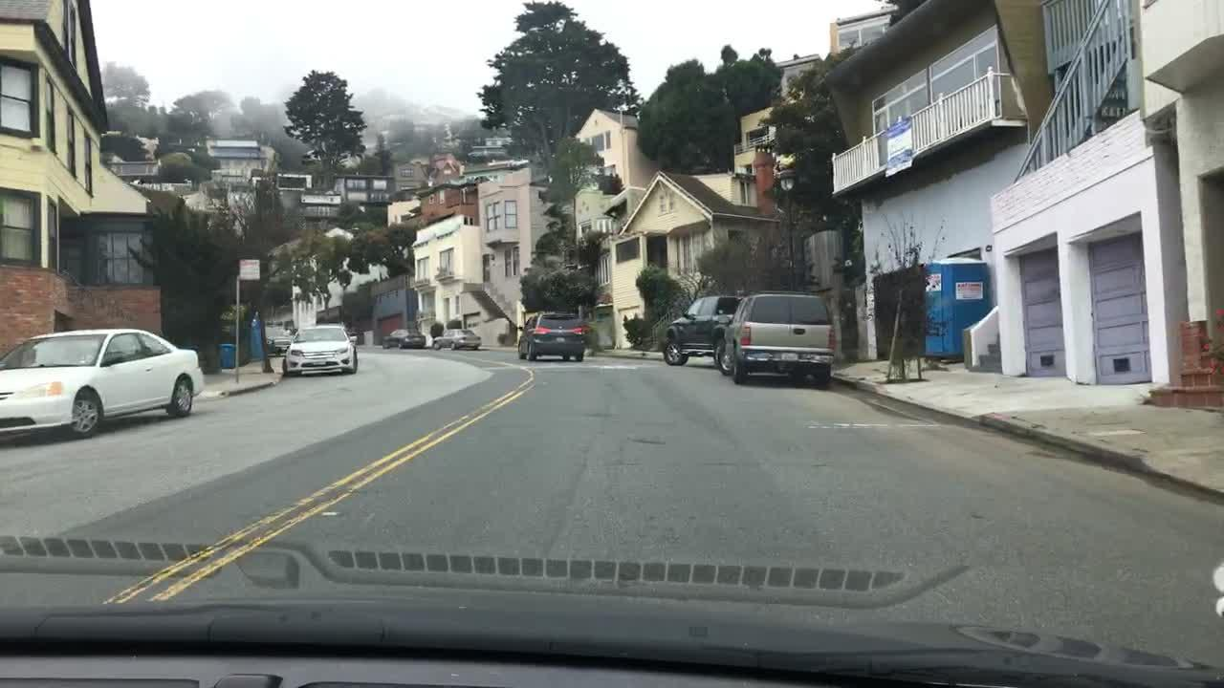
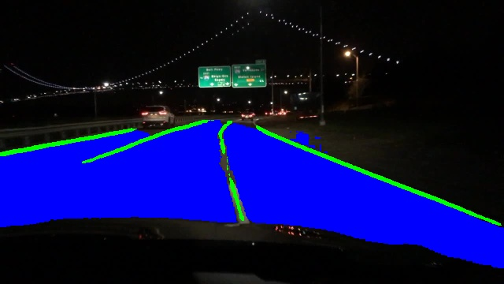
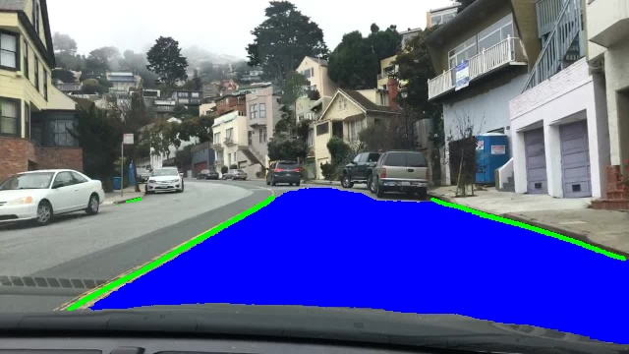
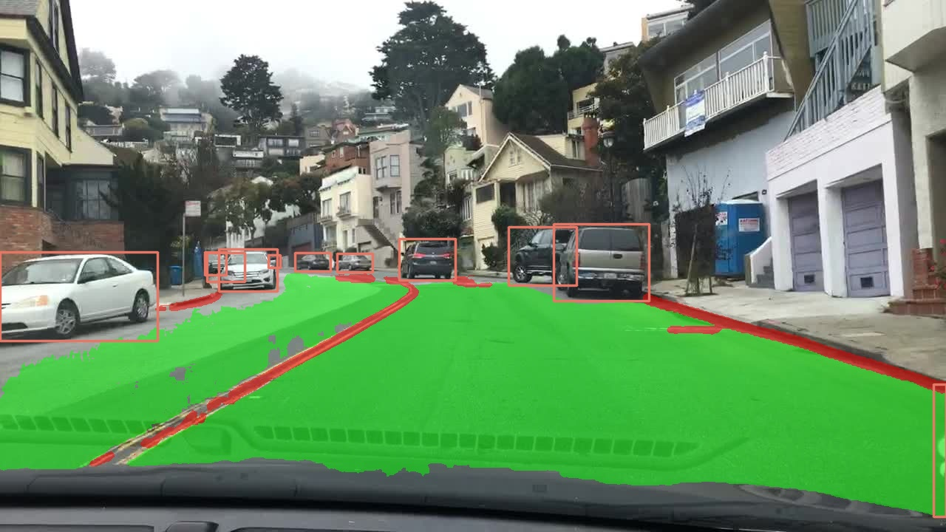
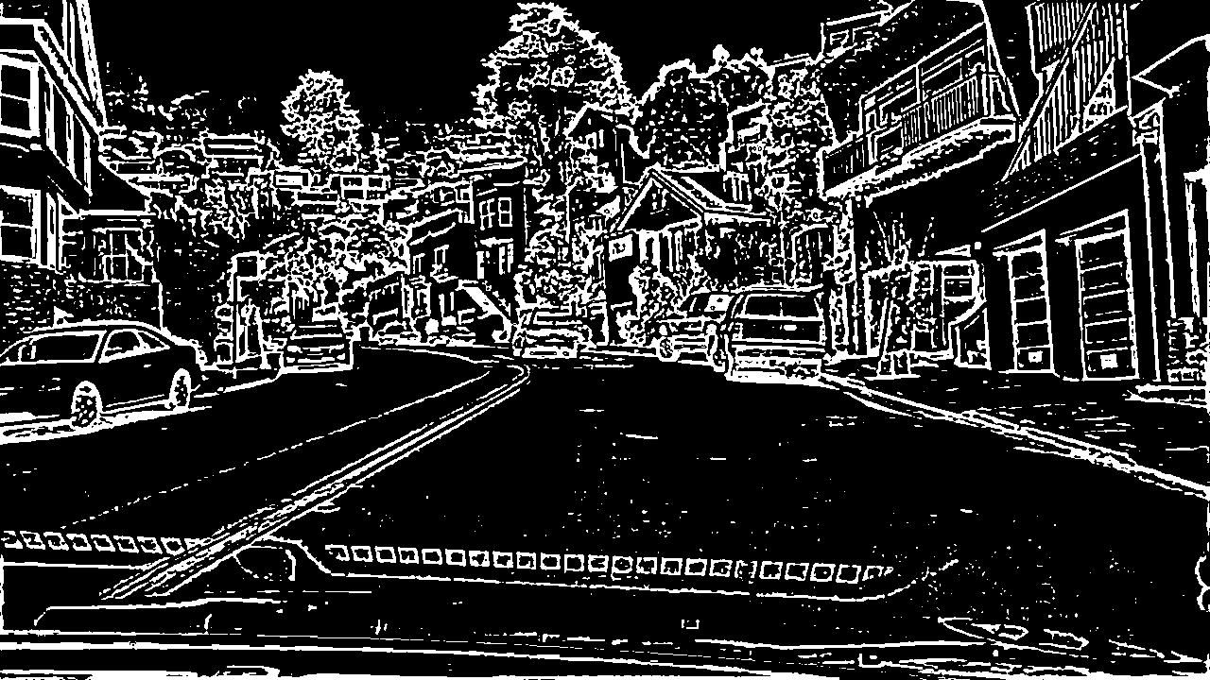
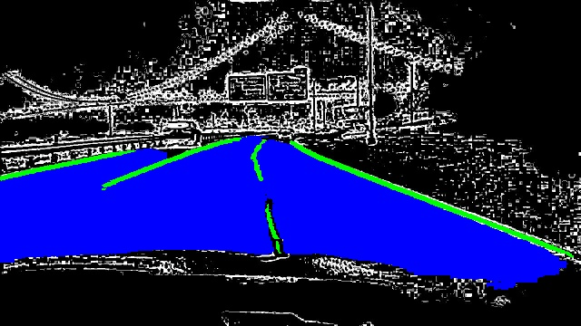
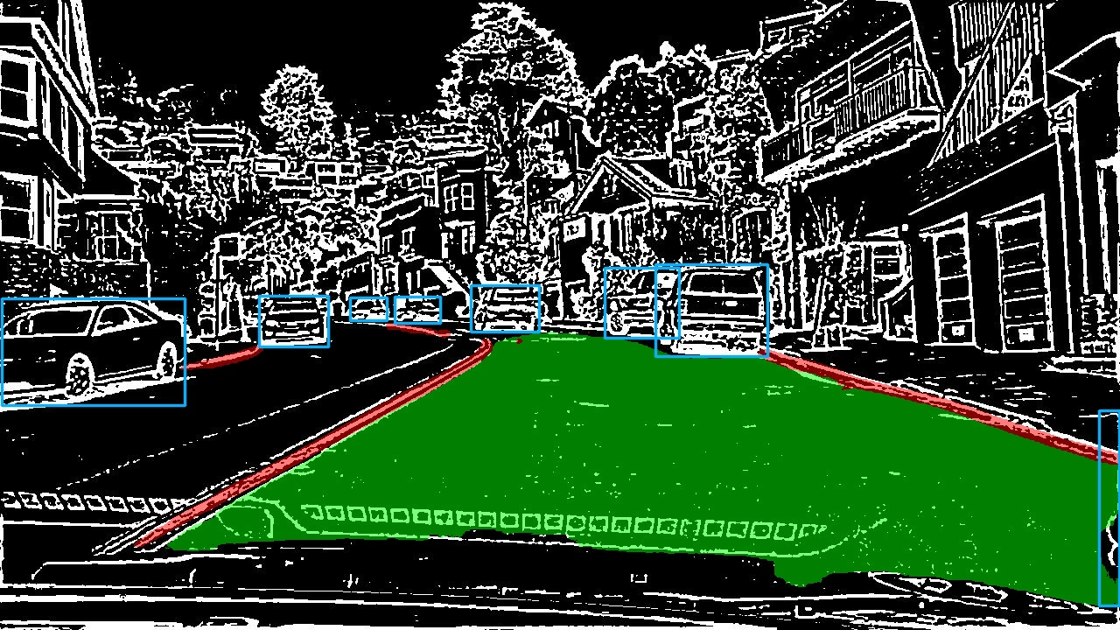
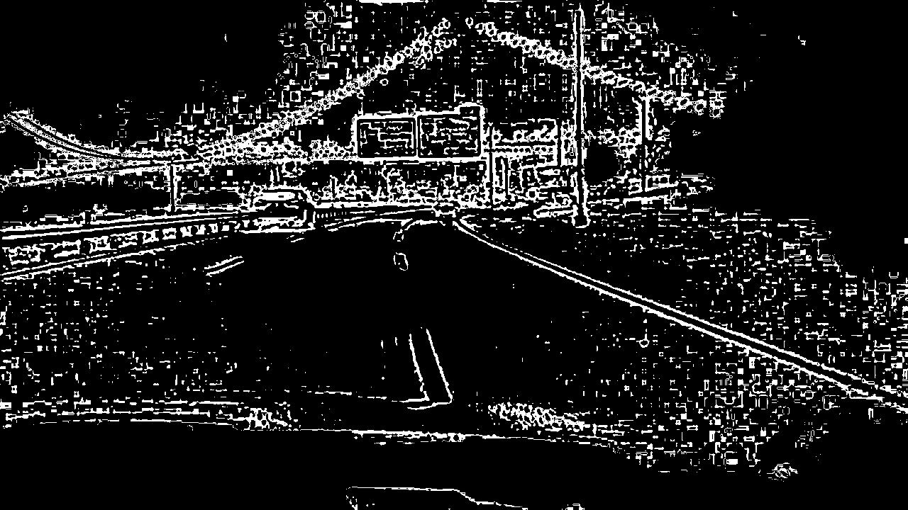
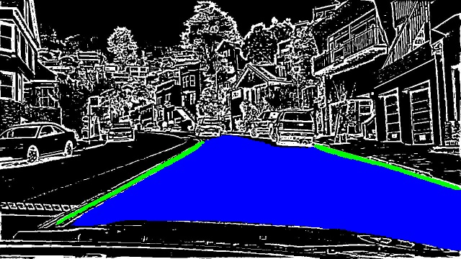
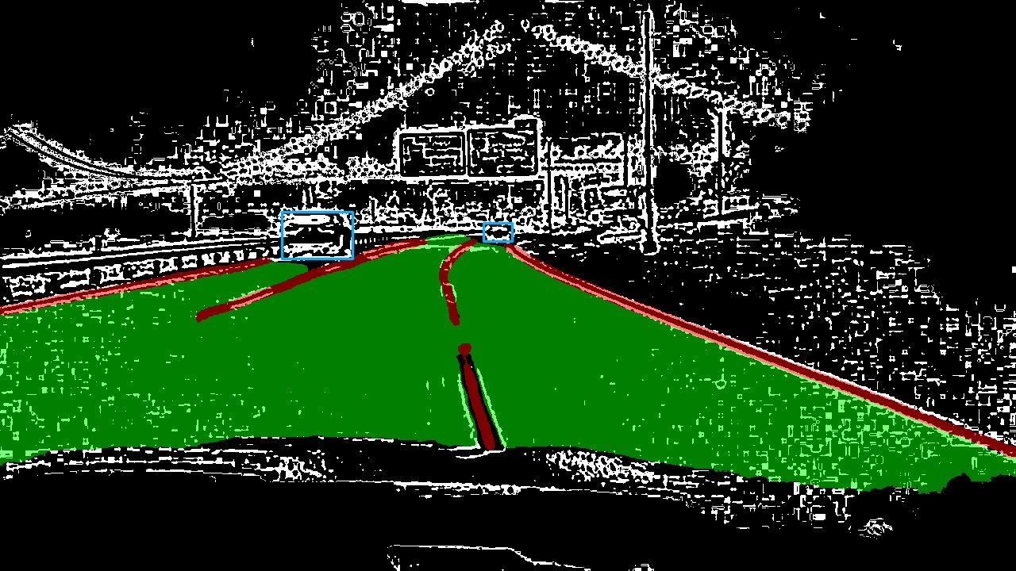
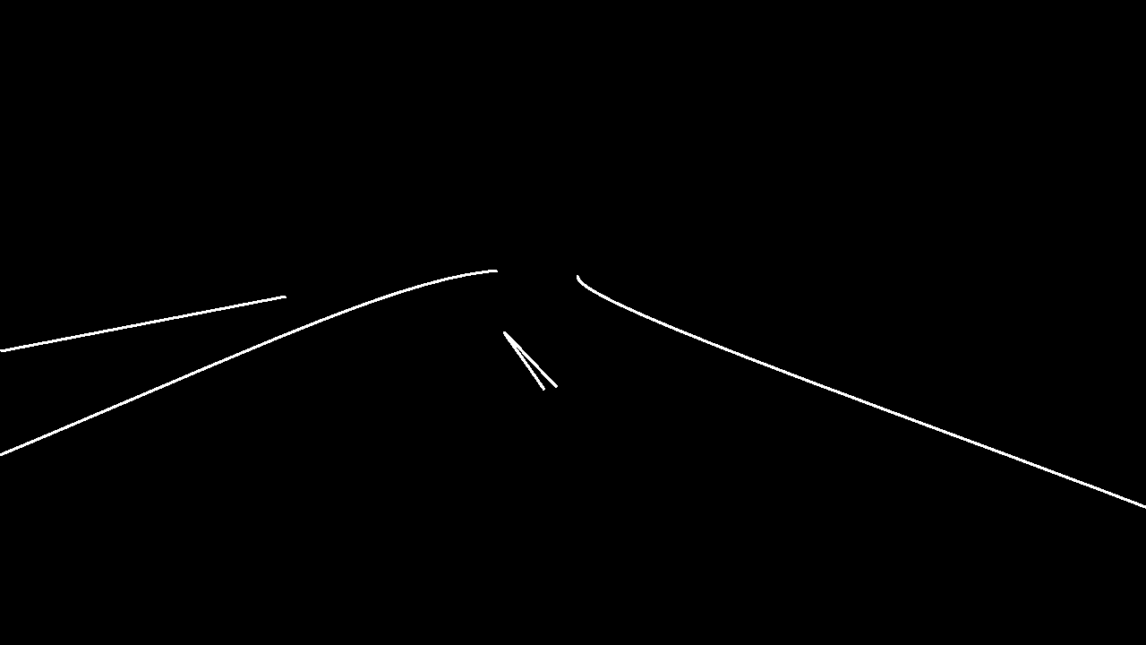
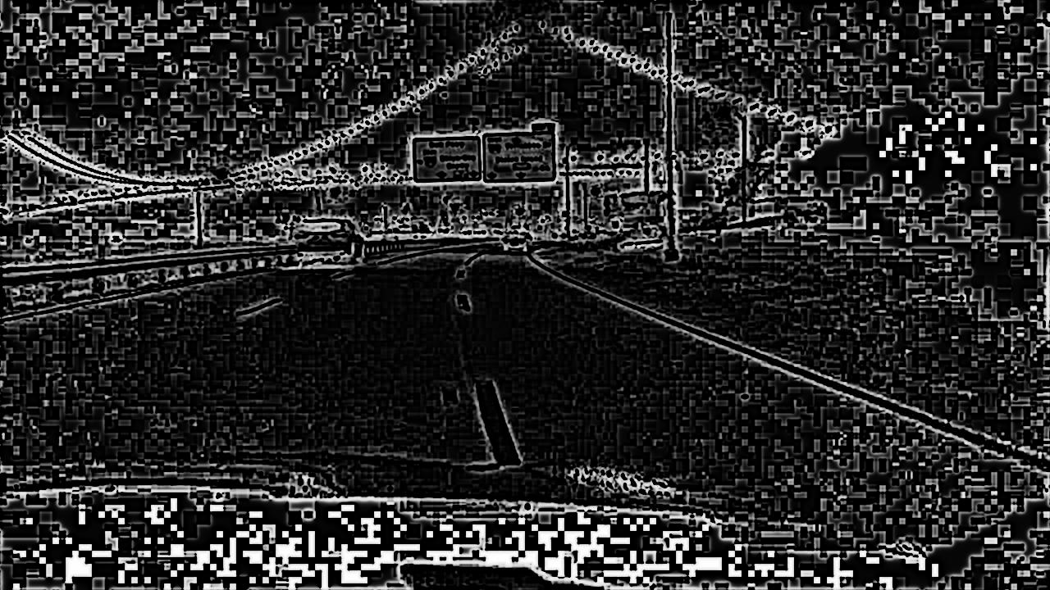
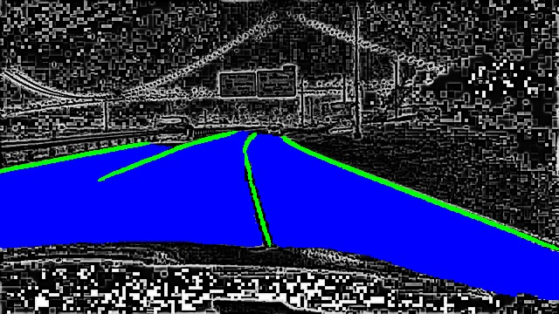
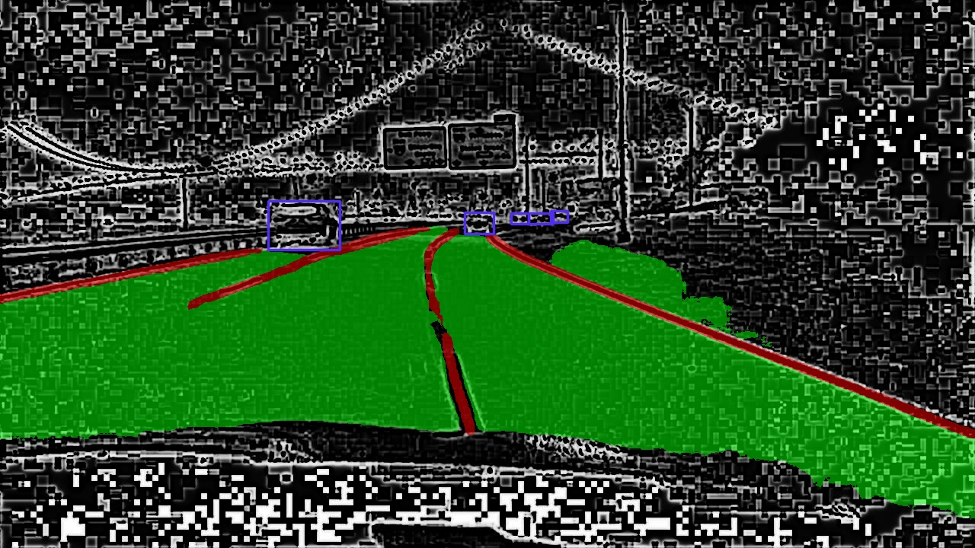
 | Input Image | TwinLiteNet Output | YOLOP Output
Benchmark
Digital PhyCV Pre- Processed Data
Analog PhyCV Pre- Processed Data
Ground Truth
Original BDD100K data
Combined Lines

Slide 34
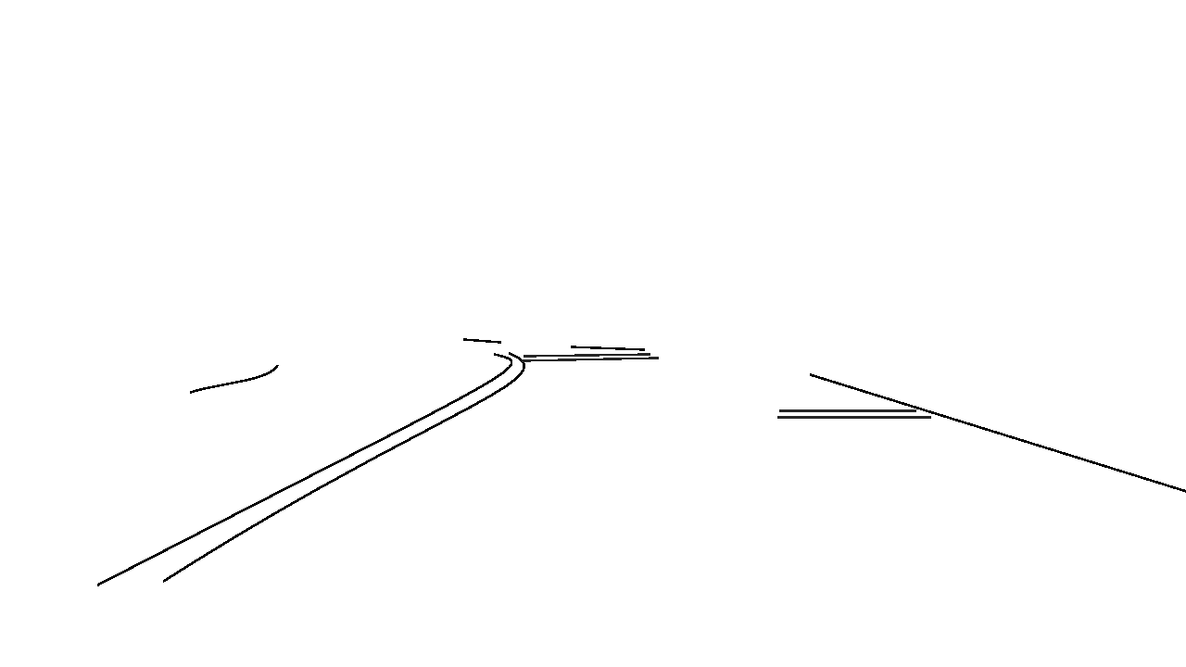
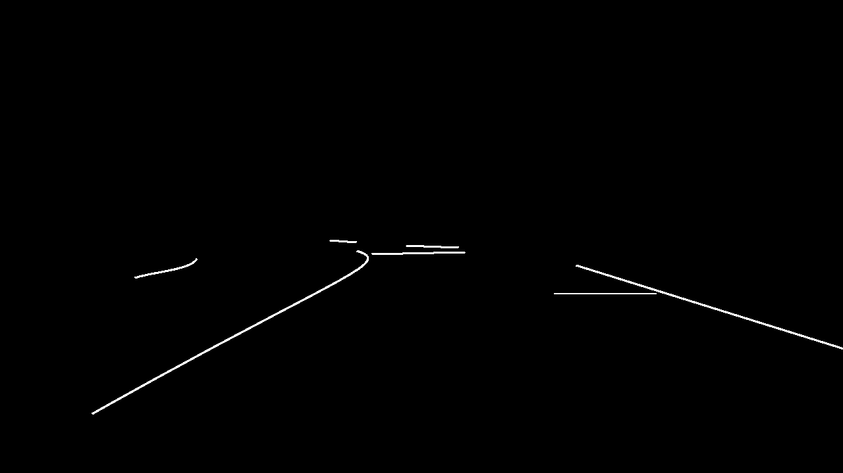



 | Input Image | TwinLiteNet Output | YOLOP Output
Benchmark
Digital PhyCV Pre- Processed Data
Analog PhyCV Pre- Processed Data
Ground Truth
Original BDD100K data
Combined Lines

Slide 35
Conclusions & Outlook
Pre-processing with PhyCV algorithms is promising in its ability to highlight lane lines and bring out details in low-light environments
Training with pre-processed data shows quantitative improvement for the YOLOP model on the validation set IOU
Morphological operations applied after PhyCV are important to prevent loss of information (digital vs analog)
Qualitatively, invisible lane line problem seems to be reduced by PhyCV pre-processing
Future directions:
Changing parameters in PhyCV pre-processing?
Changing hyperparameters (e.g., batchsize) in neural network training?

Slide 36
Reference
BDD100K Dataset
Documentation: https://doc.bdd100k.com
Download: https://bdd-data.berkeley.edu/
YOLOP: You Only Look Once for Panoptic Driving Perception by Wu et al.
Github: https://github.com/hustvl/YOLOP
Paper: https://arxiv.org/pdf/2108.11250.pdf
TwinLiteNet: An Efficient and Lightweight Model for Driveable Area and Lane Segmentation in Self-Driving Cars
Github: https://github.com/chequanghuy/TwinLiteNet
Paper: https://arxiv.org/pdf/2307.10705.pdf
You Only Look at Once for Real-Time and Generic Multi-Task by Wang et al.
Paper: https://arxiv.org/pdf/2310.01641v3.pdf
PhyCV: The First Physics-inspired Computer Vision Library by Zhou et al.
Github: https://github.com/JalaliLabUCLA/phycv
Paper: https://arxiv.org/pdf/2301.12531.pdf
How to Evaluate an Object Detection Model: Explain IoU, Precision, Recall and mAP with examples
Article: https://zihaogeng.medium.com/how-to-evaluate-an-object-detection-model

Slide 37
Thank you!

Slide 38
Future Work: Training on PST Preprocessed Data

Slide 39
Future Plan
Train the benchmark model on PST preprocessed data
Current plan: Use SuperGradients + PyTorch Hub to simplify code
Considering using both PST preprocessed data and original data as input together
Train the benchmark model with less parameters on PST preprocessed data
Compare the PST preprocessed model with the benchmark on specific environment conditions, including nighttime and fog

Slide 40
Structure:
Motivation - Why lane detection is important
Background - What is PST and how can it be useful (maybe also mention VEVID)
Dataset - What are the X, Y data from BDD100K
YOLOP benchmark - What is the network architecture/training + inference example + inference metrics/results
PST preprocessing - What are the challenges/what do the parameters do (maybe also mention VEVID)
Future Directions - Training on PST data

Slide 41
Results of YOLOP Inference
 | Accuracy | IoU
Train Data | 0.7647 | 0.1809
Validation Data | 0.7638 | 0.1787
Note: these results are not as good as the paper since they lowered resolution of images from 1280x720 to 640x384 and merged lane lines into solid lines

Slide 42



Inference Example - Lane Detection
Predicted
Ground Truth

Slide 43



Inference Example - Lane Detection
Predicted
Ground Truth

Slide 44


Original
Input
Neural network
Output
PST
implemented by PhyCV
Improved
Input
PhyCV output
VEViD
Source: https://arxiv.org/abs/2108.11250
Output
Neural network

Slide 45
YOLOP - Architecture
1 shared encoder, 3 separate decoders (7.9 million trainable parameters)
Source: https://arxiv.org/pdf/2108.11250.pdf

Slide 46




Challenges PST cannot fix - Invisible Lane Lines
Original
Image
PST
Ground
Truth
YOLOP

Slide 47



BDD100K Dataset - Lane Detection
100K Images - 70k train, 10k validation, 20k test
8 bits:
Source: https://doc.bdd100k.com/format.html#segmentation-formats

